Slide 1
Random cheese simulation workflow

Slide 2
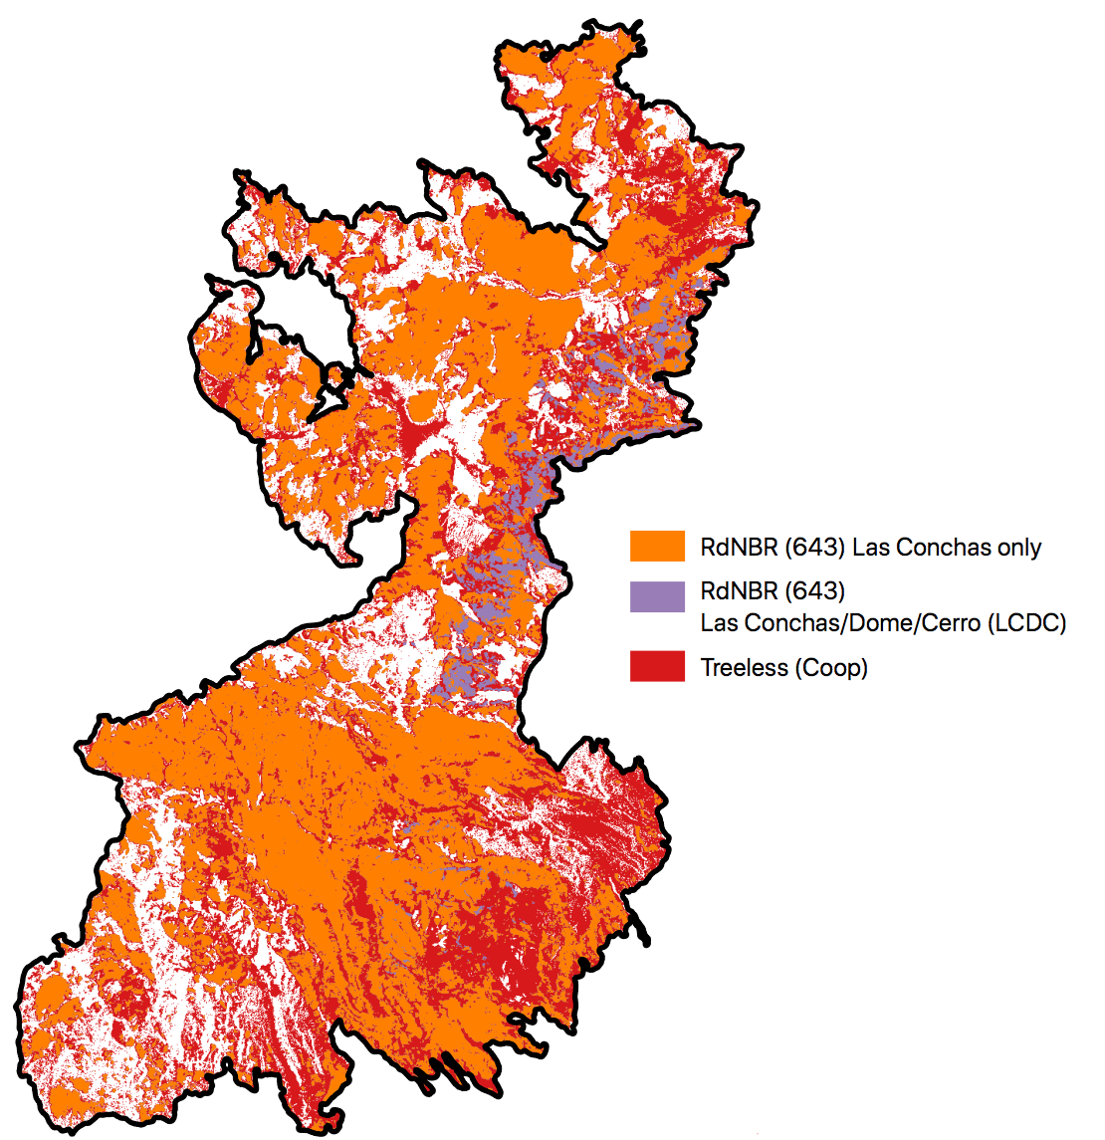
3 observed “high severity” scenarios
Las Conchas RdNBR is least expansive
Coop “Treeless” layer is most expansive

Slide 3
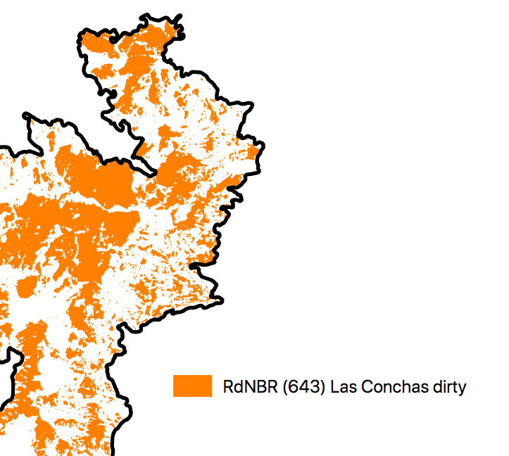

Objective 1: “Clean” each observed scenario
Remove “holes” < 1 ha
Remove “crumbs” < 1 ha

Slide 4
“Cut” the cleaned polygons at pinch points
The objective is to produce more biologically meaningful patch size distributions.
Iteratively buffer every polygon inward by 15 m.
If this creates multiple “chunks” > 10 ha, find the narrowest point of the original polygon where the smallest chunk connects to the nearest chunk. Cut polygon there.
Keep doing this until no more 10 ha chunks are created.
Chunks can be split repeatedly
Then repeat the process with 30, 60 and 120 m buffer increments.
120 m increments means that the center of the narrowest “bridge” between chunks is never more than 120 m from patch edge (reasonable PIPO dispersal distance)
examples

Slide 5
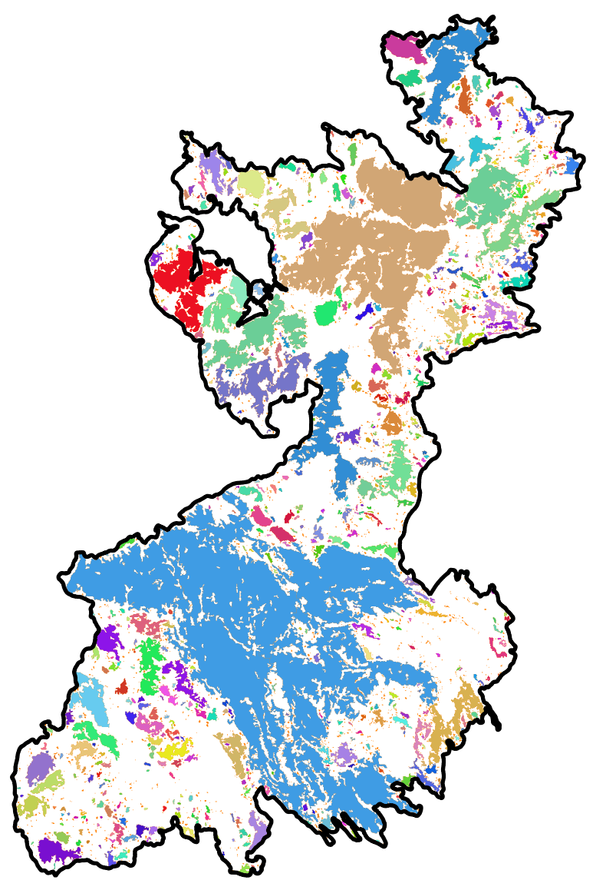
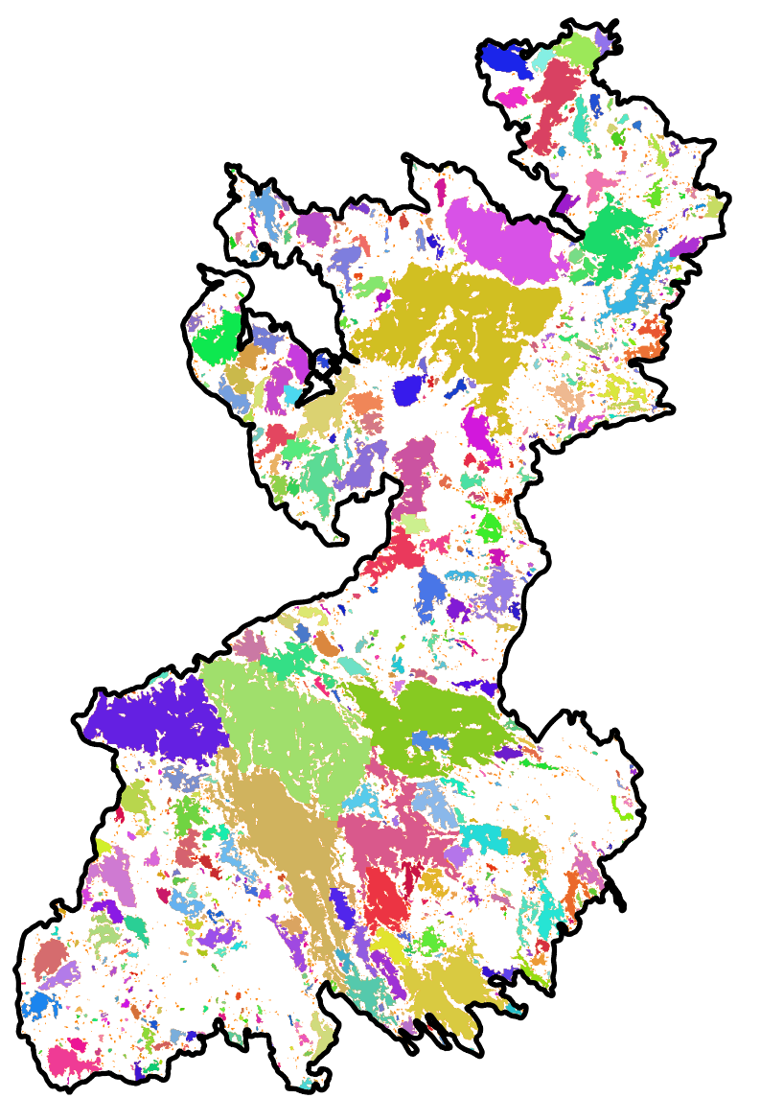
Clean-Cut Results (Las Conchas RdNBR example)
Cut
Clean-Uncut
Fatter, shorter tail here (among patches >10 ha)

Slide 6
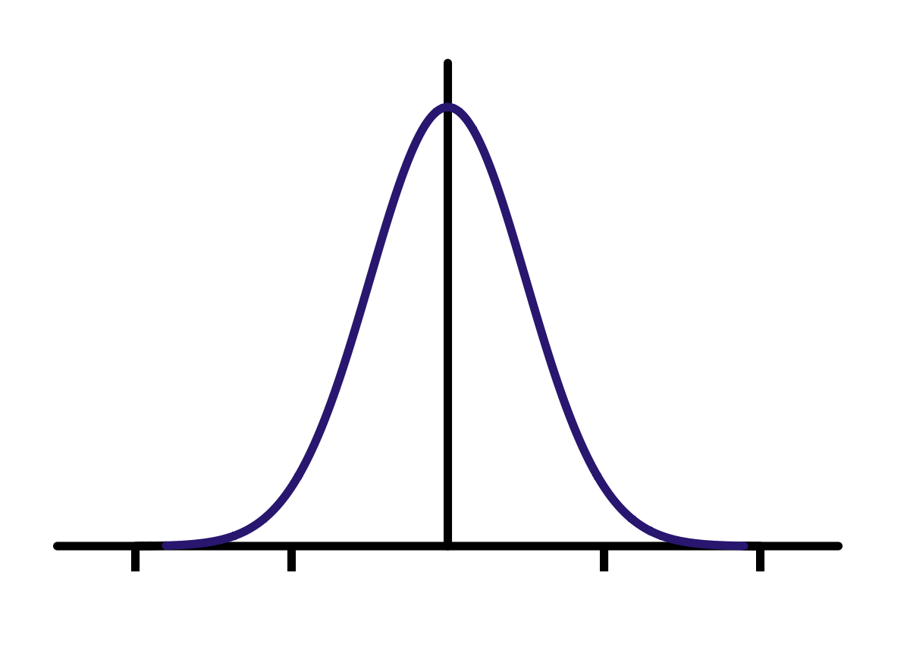
Objective 2: Simulate fake high severity patches
0
0.5
1

Slide 7
Generate spatially continuous Gaussian random field to produce “fake patches”
Range = 67 (pct = 1% of grid area)
Nugget = 0
MagVar = 100
“Gaussian field” is a pixel-by-pixel representation of a normal distribution with some degree of spatial autocorrelation between pixels.
Key parameters:
Range: Maximum range (raster units) of spatial autocorrelation.
Equivalent to the radius of a circle with an area equal to 'pct' percent of the grid area
Nugget: Magnitude of variation in the scale of Range, larger values produce “spray paint” effect where some pixels are completely independent of the world around them. Want this to be small.
MagVar: Magnitude of variation over the entire landscape; unclear the importance but doesn’t have much impact.
Simulated rectangular landscape is 125541 ha

Slide 8
Comparing different parameter values: Range
deprecate
Range = 67 (pct = 1)
Nugget = 1
MagVar = 100
“Gaussian field” is a pixel-by-pixel representation of a normal distribution with some degree of spatial autocorrelation between pixels.
Key parameters:
Range: Maximum range (raster units) of spatial autocorrelation.
Equivalent to the radius of a circle with an area equal to 'pct' percent of the grid area
Nugget: Magnitude of variation in the scale of Range, smaller values lead to more homogeneous landscapes.
MagVar: Magnitude of variation over the entire landscape

Slide 9
Convert continuous field to binary field
Range = 67 (pct = 1)
Nugget = 0
MagVar = 100
PctBurn = 20
Using original example landscape
PctBurn parameter set to 20% in this case (results in 20% of the landscape in high-severity fire).
Cumulative
proportion
Pixel value

Slide 10
Objective 3: Determine optimal parameters to match observed patch distribution
One example of a simulation
Range = 67 (pct = 1)
Nugget = 0
MagVar = 100
PctBurn = 42.4% (same as LC)
Obs PctBurn (after clipping to Las Conchas perimeter) = 46.8 % (there is some randomness to the clip)
Will tweak the first three parameters to minimize the residuals between simulated (blue dots) and observed (blue line)
N patches
Log₂(patch size area)

Slide 11
Objective 4: Overlay scars, calculate proportion of scars intersecting a simulated high-severity patch
Previous example:
orange: hits; green: misses

Slide 12
Objective 1: Define random field parameters to match “clean” Las Conchas patch distribution
Task 1.1: Simplify Las Conchas patch distribution
“fill holes” (refugia) that are <= 1ha
“remove crumbs” (small high severity patches) that are <= 1ha
“cut” high severity patches
Example: Las Conchas RdNBR
before
after

